Slide 1

FACULTY OF INFORMATION TECHNOLOGY
FALL, 2020
Lecture 1 - Linear equations in Linear Algebra
9/28/2021
9/28/2021
Lecture 1 - Linear equation in Linear Algebra
Lecture 1 : Linear Equation in Linear Algebra
Lecture 1 : Linear Equation in Linear Algebra
1
1
1
Notes:
1

Slide 2
Contents
Symstems of Linear Equation
Row reductions and Echelon Forms
Vector Equations
The Matrix Equation Ax = b
Solution Set of Linear Equations
1
2
3
4
5
28/09/2021
Lecture 1 : Linear Equation in Linear Algebra
2
2
2
2

Slide 3
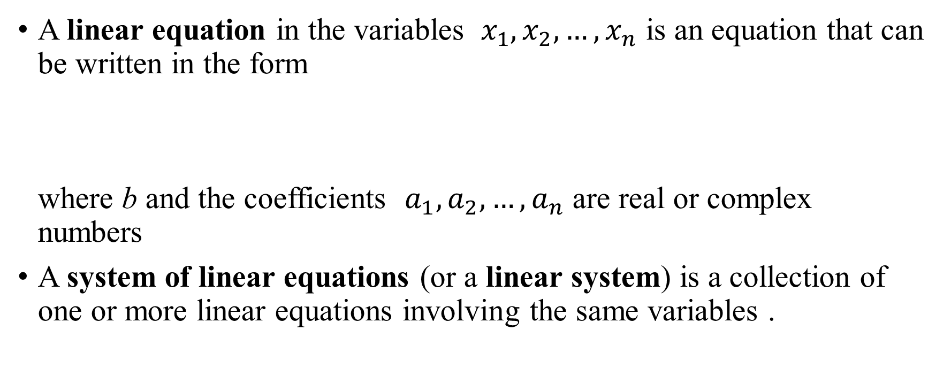
1.1 Symstems of Linear Equations
A linear equation in the variables ${ x}_{1},x_{2},…,x_{n}$ is an equation that can be written in the form
where b and the coefficients $a_{1},a_{2},…,a_{n}$ are real or complex numbers
A system of linear equations (or a linear system) is a collection of one or more linear equations involving the same variables .
9/28/2021
9/28/2021
Lecture 1 : Linear Equation in Linear Algebra
Lecture 1 : Linear Equation in Linear Algebra
Lecture 1 : Linear Equation in Linear Algebra
3
3
3
3

Slide 4
Linear Equation
A system of linear equations has
no solution, or
exactly one solution, or
infinitely many solutions.
A system of linear equations is said to be consistent if it has either one solution or infinitely many solutions.
A system is inconsistent if it has no solution
9/28/2021
9/28/2021
Lecture 1 - Linear equation in Linear Algebra
Lecture 1 : Linear Equation in Linear Algebra
Lecture 1 : Linear Equation in Linear Algebra
4
4
4

Slide 5
Linear Equation
The essential information of a linear system can be recorded
compactly in a rectangular array called a matrix. Given the system,
with the coefficients of each variable aligned in columns,
coefficient matrix augmented matrix
9/28/2021
9/28/2021
Lecture 1 - Linear equation in Linear Algebra
Lecture 1 : Linear Equation in Linear Algebra
Lecture 1 : Linear Equation in Linear Algebra
5
5
5

Slide 6
SOLVING SYSTEM OF EQUATIONS
Example 1: Solve the given system of equations.
Solution : We consider the corresponding augmented matrix
9/28/2021
9/28/2021
Lecture 1 - Linear equation in Linear Algebra
Lecture 1 : Linear Equation in Linear Algebra
Lecture 1 : Linear Equation in Linear Algebra
6
6
6

Slide 7
SOLVING SYSTEM OF EQUATIONS
R1x4-R3
R2/2
R2+4R3
R3+3R2
R1+2R2
triangular form.
Notes:
Keep x₁ in the first equation and eliminate it from the other equations. To do so, add 4 times equation 1 to equation 3
7

Slide 8
ELEMENTARY ROW OPERATIONS
Elementary row operations include the following:
(Replacement) Replace one row by the sum of itself and a multiple of another row.
(Interchange) Interchange two rows.
(Scaling) Multiply all entries in a row by a nonzero constant.
9/28/2021
9/28/2021
Lecture 1 : Linear Equation in Linear Algebra
Lecture 1 : Linear Equation in Linear Algebra
8

Slide 9
EXISTENCE AND UNIQUENESS OF SYSTEM OF EQUATIONS
Two fundamental questions about a linear system are as follows:
Is the system consistent; that is, does at least one solution exist?
If a solution exists, is it the only one; that is, is the solution unique?
In Example 1 : (29,16,3) is a solution of the system . Thus the system is consistent.
9/28/2021
9/28/2021
Lecture 1 - Linear equation in Linear Algebra
Lecture 1 : Linear Equation in Linear Algebra
Lecture 1 : Linear Equation in Linear Algebra
9
9
9

Slide 10
1.2 ROW REDUCTION AND
ECHELON FORM

Slide 11
Row Reduction and Echelon Form
A rectangular matrix is in echelon form (or row echelon form) if it has the following three properties:
All nonzero rows are above any rows of all zeros.
Each leading entry of a row is in a column to the right of the leading entry of the row above it.
All entries in a column below a leading entry are zeros.
9/28/2021
9/28/2021
Lecture 1 - Linear equation in Linear Algebra
Lecture 1 : Linear Equation in Linear Algebra
Lecture 1 : Linear Equation in Linear Algebra
11
11
11

Slide 12
PIVOT POSITION
Definition : A pivot position in a matrix A is a location in A that corresponds to a leading 1 in the reduced echelon form of A. A pivot column is a column of A that contain a pivot position.
9/28/2021
9/28/2021
Lecture 1 - Linear equation in Linear Algebra
Lecture 1 : Linear Equation in Linear Algebra
Lecture 1 : Linear Equation in Linear Algebra
12
12
12

Slide 13
PIVOT POSITION
Example 2: Row reduce the matrix A below to echelon form, and locate
the pivot columns of A.
Solution: The top of the leftmost nonzero column is the first pivot
position. A nonzero entry, or pivot, must be placed in this position.
9/28/2021
9/28/2021
Lecture 1 - Linear equation in Linear Algebra
Lecture 1 : Linear Equation in Linear Algebra
Lecture 1 : Linear Equation in Linear Algebra
13
13
13

Slide 14
PIVOT POSITION
Pivot
Pivot
Next pivot column
Pivot column
Pivot
9/28/2021
Pivot columns
9/28/2021
Lecture 1 : Linear Equation in Linear Algebra
Lecture 1 : Linear Equation in Linear Algebra
14
14
Notes:
This is an example of an echelon form matrix
14

Slide 15
ROW REDUCTION ALGORITHM
Example: Apply elementary row operations to transform the following matrix first into echelon form and then into reduced echelon form:
STEP 1: Begin with the leftmost nonzero column. This is a pivot column. The pivot position is at the top.
9/28/2021
9/28/2021
Lecture 1 - Linear equation in Linear Algebra
Lecture 1 : Linear Equation in Linear Algebra
Lecture 1 : Linear Equation in Linear Algebra
15
15
15

Slide 16
ROW REDUCTION ALGORITHM
Piovt column
STEP 2: Select a nonzero entry in the pivot column as a pivot. If necessary, interchange rows to move this entry into the pivot position
9/28/2021
9/28/2021
Lecture 1 - Linear equation in Linear Algebra
Lecture 1 : Linear Equation in Linear Algebra
Lecture 1 : Linear Equation in Linear Algebra
16
16
16

Slide 17
ROW REDUCTION ALGORITHM
Interchange rows 1 and 3. (We could have interchanged rows 1 and 2 instead)
STEP 3: Use row replacement operations to create zeros in all positions below the pivot.
Pivot
9/28/2021
9/28/2021
Lecture 1 : Linear Equation in Linear Algebra
Lecture 1 : Linear Equation in Linear Algebra
17
17

Slide 18
ROW REDUCTION ALGORITHM
Step 4 : With row 1 covered, step 1 shows that column 2 is the next pivot column; for step 2, select as a pivot the “top” entry in that column
For step 3, we could insert an optional step of dividing the “top” row of the submatrix by the pivot, 2. Instead, we add- 3/2 times the “top” row to the row below.
Pivot
New pivot column
9/28/2021
9/28/2021
Lecture 1 : Linear Equation in Linear Algebra
Lecture 1 : Linear Equation in Linear Algebra
18
18
Notes:
18

Slide 19
ROW REDUCTION ALGORITHM
When we cover the row containing the second pivot position for step 4, we are left with a new submatrix that has only one row.
Step 5 : Beginning with the rightmost pivot and working upward and to the left, create zeros above each pivot. If a pivot is not 1, make it 1 by a scaling operation.
9/28/2021
9/28/2021
Lecture 1 : Linear Equation in Linear Algebra
Lecture 1 : Linear Equation in Linear Algebra
19
19

Slide 20
ROW REDUCTION ALGORITHM
The next pivot is in row 2. Scale this row, dividing by the pivot.
Create a zero in column 2 by adding 9 times row 2 to row 1.
9/28/2021
9/28/2021
Lecture 1 : Linear Equation in Linear Algebra
Lecture 1 : Linear Equation in Linear Algebra
20
20

Slide 21
ROW REDUCTION ALGORITHM
Finally, scale row 1, dividing by the pivot, 3.
This is the reduced echelon form of the original matrix.
9/28/2021
9/28/2021
Lecture 1 : Linear Equation in Linear Algebra
Lecture 1 : Linear Equation in Linear Algebra
21
21

Slide 22
SOLUTIONS OF LINEAR SYSTEMS
Suppose, for example, that the augmented matrix of a linear system has been changed into the equivalent reduced echelon form.
There are three variables because the augmented matrix has four columns. The associated system of equations is
9/28/2021
9/28/2021
Lecture 1 : Linear Equation in Linear Algebra
Lecture 1 : Linear Equation in Linear Algebra
22
22

Slide 23
SOLUTIONS OF LINEAR SYSTEMS
The variables x₁ and x₂ corresponding to pivot columns in the matrix are called basic variables. The other variable, x₃, is called a free variable.
For instance, when , the solution is (1,4,0); when , the solution is (6,3,1).
9/28/2021
9/28/2021
Lecture 1 : Linear Equation in Linear Algebra
Lecture 1 : Linear Equation in Linear Algebra
23
23

Slide 24
EXISTENCE AND UNIQUENESS THEOREM
Existence and Uniqueness Theorem
A linear system is consistent if and only if the rightmost column of the augmented matrix is not a pivot column—i.e., if and only if an echelon form of the augmented matrix has no row of the form
[0 … 0 b] with b nonzero.
If a linear system is consistent, then the solution set contains either
(i) a unique solution, when there are no free variables, or
(ii) infinitely many solutions, when there is at least on free variable.
9/28/2021
9/28/2021
Lecture 1 : Linear Equation in Linear Algebra
Lecture 1 : Linear Equation in Linear Algebra
24
24

Slide 25
CONCLUSION
Using Row Reduction to Solve a Linear System
Write the augmented matrix of the system.
Use the row reduction algorithm to obtain an equivalent augmented matrix in echelon form. Decide whether the system is consistent. If there is no solution, stop; otherwise, go to the next step.
Continue row reduction to obtain the reduced echelon form.
Write the system of equations corresponding to the matrix obtained in step 3.
Rewrite each nonzero equation from step 4 so that its one basic variable is expressed in terms of any free variables appearing in the equation.

Slide 26
1.3 VECTOR EQUATION

Slide 27
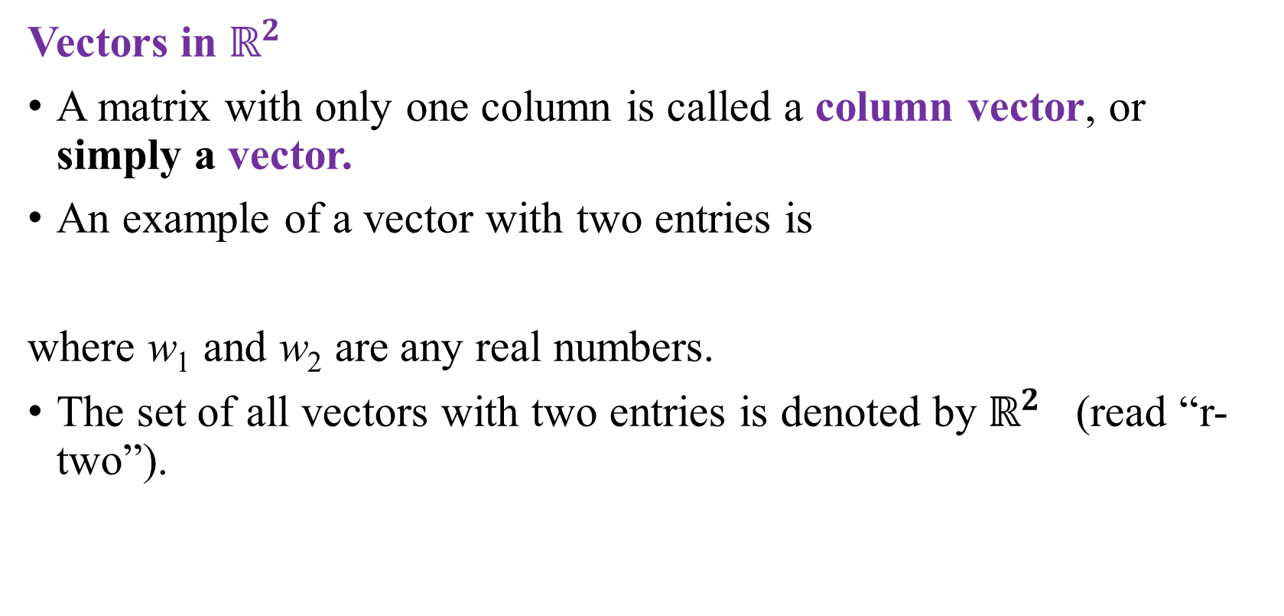
VECTOR EQUATIONS
Vectors in $ℝ^{2 }$
A matrix with only one column is called a column vector, or simply a vector.
An example of a vector with two entries is
where w₁ and w₂ are any real numbers.
The set of all vectors with two entries is denoted by $ℝ^{2}$ (read “r-two”).
9/28/2021
Lecture 1 : Linear Equation in Linear Algebra
27
Notes:
27

Slide 28
VECTOR EQUATIONS
Example 1: Given and , find 4u, , and
Solution: , and
9/28/2021
Lecture 1 : Linear Equation in Linear Algebra
28

Slide 29
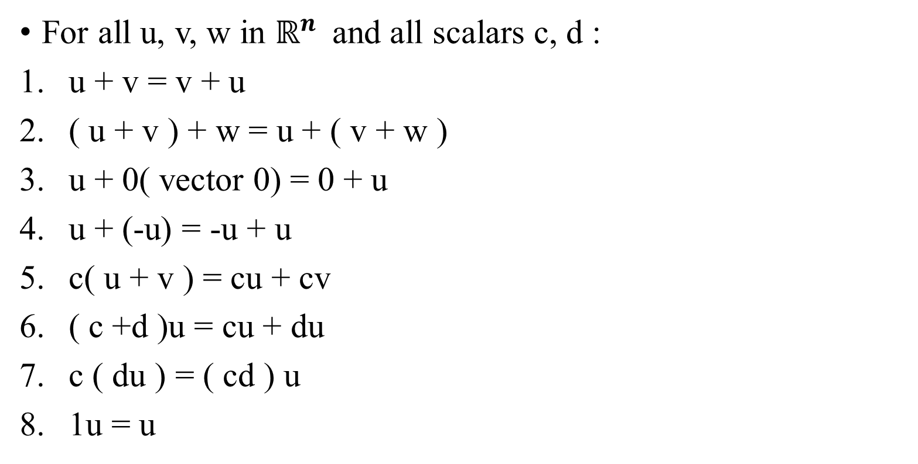
Algebraic Properties of $ℝ^{n}$
For all u, v, w in $ℝ^{n }$ and all scalars c, d :
u + v = v + u
( u + v ) + w = u + ( v + w )
u + 0( vector 0) = 0 + u
u + (-u) = -u + u
c( u + v ) = cu + cv
( c +d )u = cu + du
c ( du ) = ( cd ) u
1u = u
9/28/2021
Lecture 1 : Linear Equation in Linear Algebra
29

Slide 30
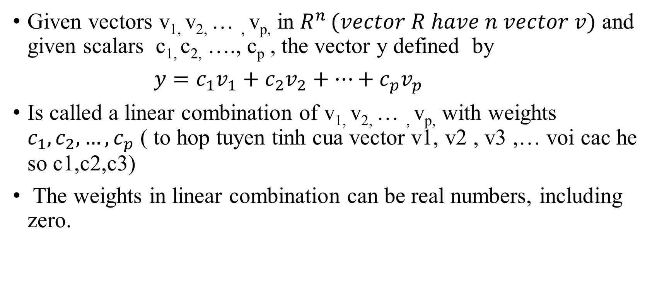
LINEAR COMBINATIONS
Given vectors v_{1,} v_{2,} … , v_{p,} in $R^{n }(vector R have n vector v)$ and given scalars c_{1,} c_{2,} …., c_{p} , the vector y defined by
$y=c_{1}v_{1}+c_{2}v_{2}+…+c_{p}v_{p}$
Is called a linear combination of v_{1,} v_{2,} … , v_{p,} with weights $c_{1},c_{2},…,c_{p}$ ( to hop tuyen tinh cua vector v1, v2 , v3 ,… voi cac he so c1,c2,c3)
The weights in linear combination can be real numbers, including zero.
9/28/2021
Lecture 1 : Linear Equation in Linear Algebra
30

Slide 31
LINEAR COMBINATIONS
Example : Let , , and
Determine whether b can be generated (or written) as a linear combination of a₁ and a₂. That is, determine whether weights x₁ and x₂ exist such that (1)
If vector equation (1) has a solution, find it.
9/28/2021
Lecture 1 : Linear Equation in Linear Algebra
31

Slide 32
LINEAR COMBINATIONS
Solution: Use the definitions of scalar multiplication( nhân 1 số với 1 vector gọi là nhân vô hướng) and vector addition to rewrite the vector equation
Which is the same as
a₁
a₂
b
9/28/2021
Lecture 1 : Linear Equation in Linear Algebra
32

Slide 33
LINEAR COMBINATIONS
And
(2)
That is, x₁ and x₂ make the vector equation (1) true if and only if x₁ and x₂ satisfy the following system.
(3)
9/28/2021
Lecture 1 : Linear Equation in Linear Algebra
33

Slide 34
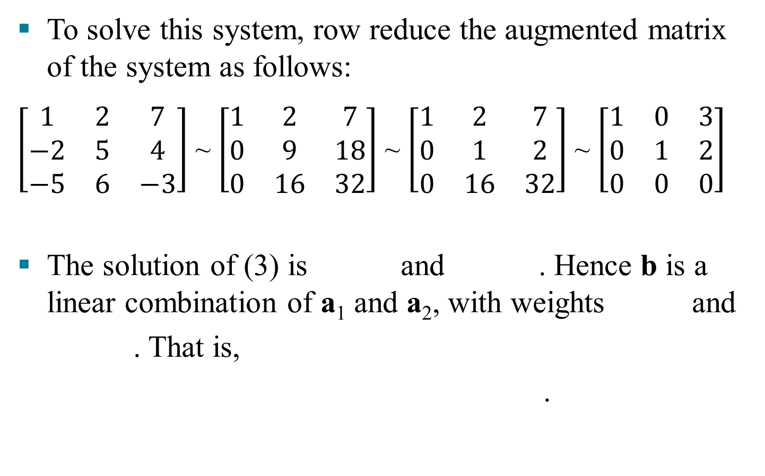
LINEAR COMBINATIONS
.
Notes:
34

Slide 35
LINEAR COMBINATIONS
Now, observe that the original vectors a₁, a₂, and b are the columns of the augmented matrix that we row reduced:
Write this matrix in a way that identifies its columns.
(4)
a₁
a₂
b
.

Slide 36
LINEAR COMBINATIONS
A vector equation
has the same solution set as the linear system whose augmented matrix is
(5)
In particular, b can be generated by a linear combination of a₁, …, a_{n} if and only if there exists a solution to the linear system corresponding to the matrix (5).
.
Slide 1.3- 36

Slide 37
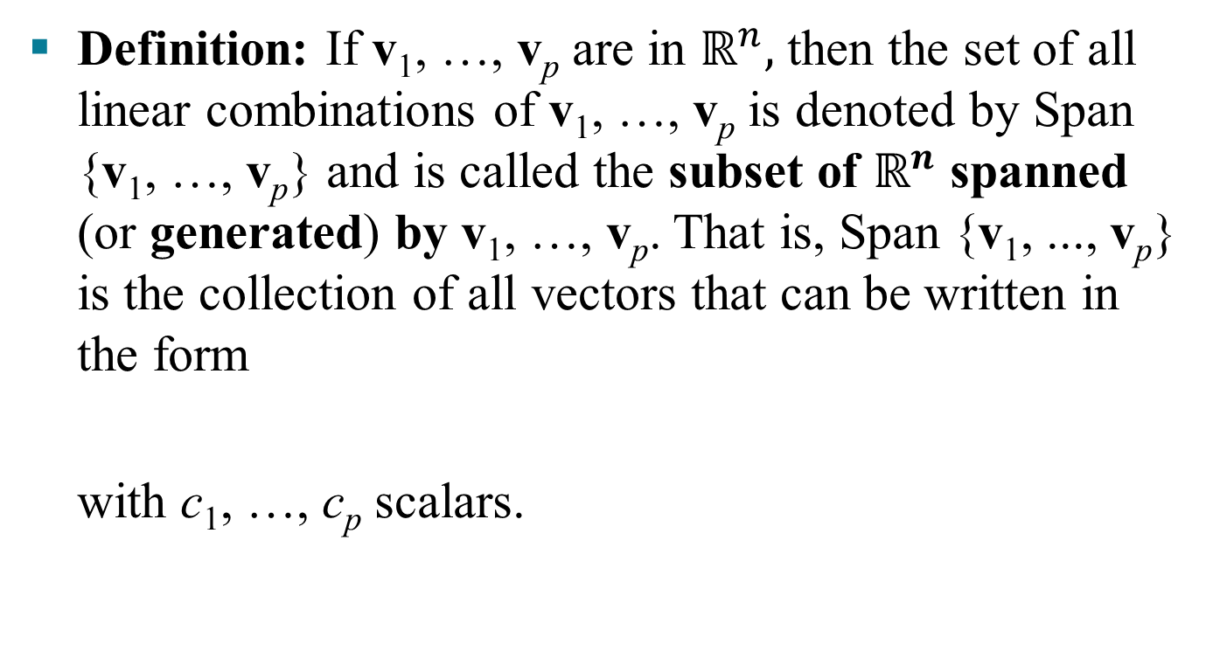
LINEAR COMBINATIONS

Slide 38
1.4 MATRIX EQUATION Ax = b

Slide 39

1.4 MATRIX EQUATION Ax = b
Definition: If A is an m x n matrix, with columns a₁, …, a_{n}, and if x is in $ℝ^{n}$, then the product of A and x, denoted by Ax, is the linear combination of the columns of A using the corresponding entries in x as weights; that is,
Note that Ax is defined only if the number of columns of A equals the number of entries in x.

Slide 40
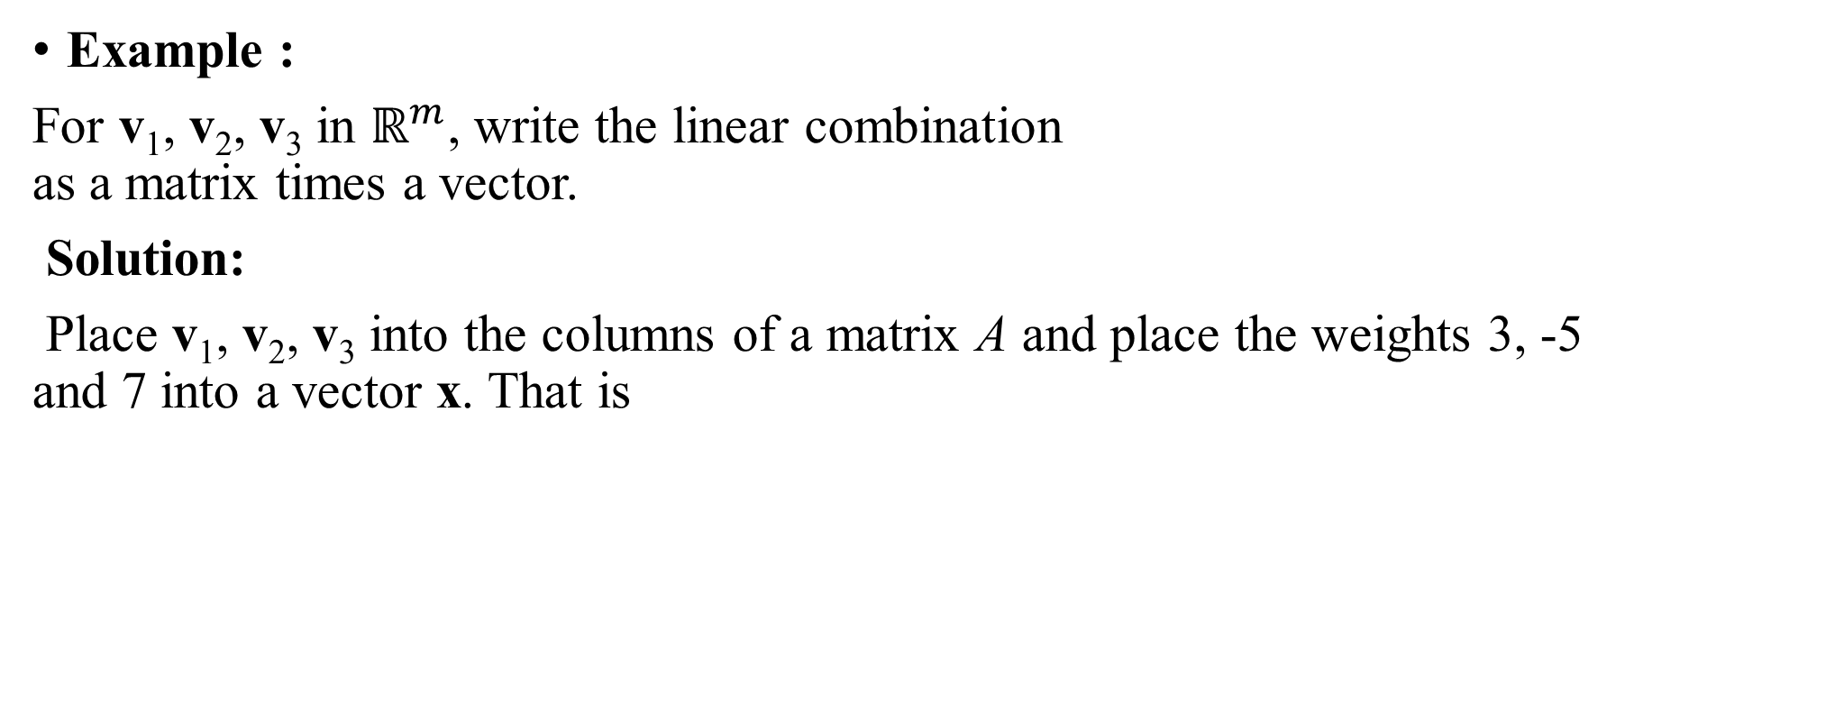
MATRIX EQUATION Ax = b
Example :
For v₁, v₂, v₃ in $ℝ^{m}$, write the linear combination as a matrix times a vector.
Solution:
Place v₁, v₂, v₃ into the columns of a matrix A and place the weights 3, -5 and 7 into a vector x. That is

Slide 41
MATRIX EQUATION Ax = b
Now, write the system of linear equations as a vector equation involving a linear combination of vectors.
For example, the following system
(1)
is equivalent to
(2)

Slide 42
MATRIX EQUATION Ax = b
As in the example, the linear combination on the left side is a matrix times a vector, so that (2) becomes
(3)
Equation (3) has the form Ax = b . Such an equation is called a matrix equation, to distinguish it from a vector equation such as shown in (2).

Slide 43
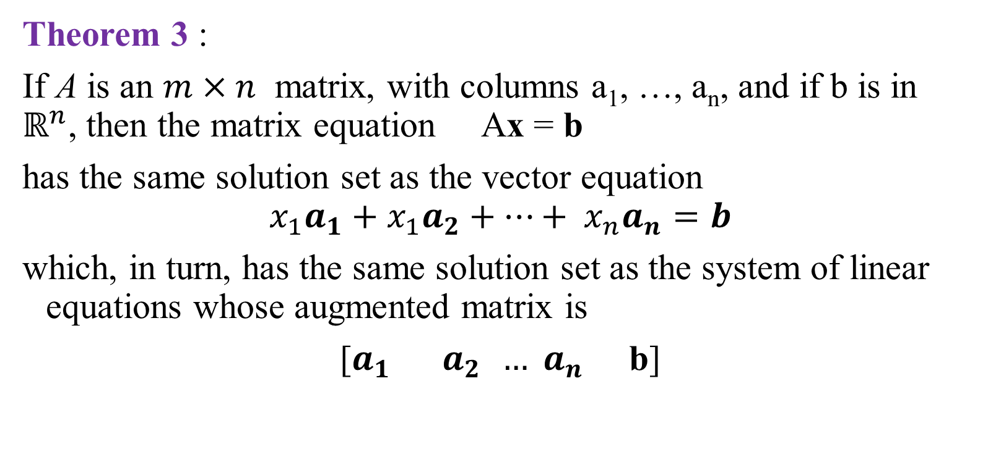
MATRIX EQUATION Ax = b
Theorem 3 :
If A is an $m×n$ matrix, with columns a₁, …, a_{n}, and if b is in $ℝ^{n}$, then the matrix equation Ax = b
has the same solution set as the vector equation
$$x_{1}a_{1}+x_{1}a_{2}+…+ x_{n}a_{n}=b$$
which, in turn, has the same solution set as the system of linear equations whose augmented matrix is
[$a_{1}{ a}_{2 }{… a}_{n}$ b]

Slide 44
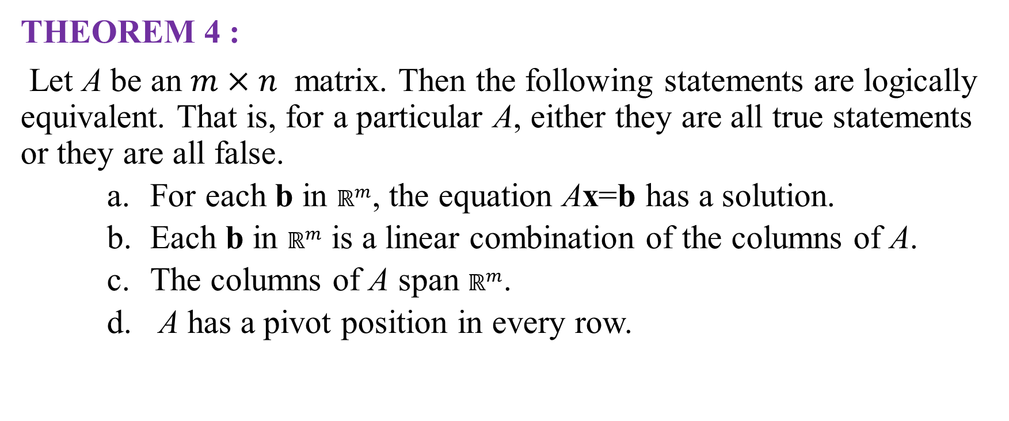
EXISTENCE OF SOLUTIONS
THEOREM 4 :
Let A be an $m×n$ matrix. Then the following statements are logically equivalent. That is, for a particular A, either they are all true statements or they are all false.
For each b in $ℝ^{m}$, the equation Ax=b has a solution.
Each b in $ℝ^{m}$ is a linear combination of the columns of A.
The columns of A span $ℝ^{m}$.
A has a pivot position in every row.

Slide 45

PROPERTIES OF THE MATRIX-VECTOR PRODUCT Ax
Theorem:
If A is an (m x n) matrix, u and v are vectors in ${ ℝ}^{n}$, and c is a scalar, then
A (u + v) = Au + Av
A(cu) = c (Au)
Notes:
Teacher prove this theorem by hand in blackboard
45

Slide 46
1.5 SOLUTION SETS
OF LINEAR SYSTEM

Slide 47
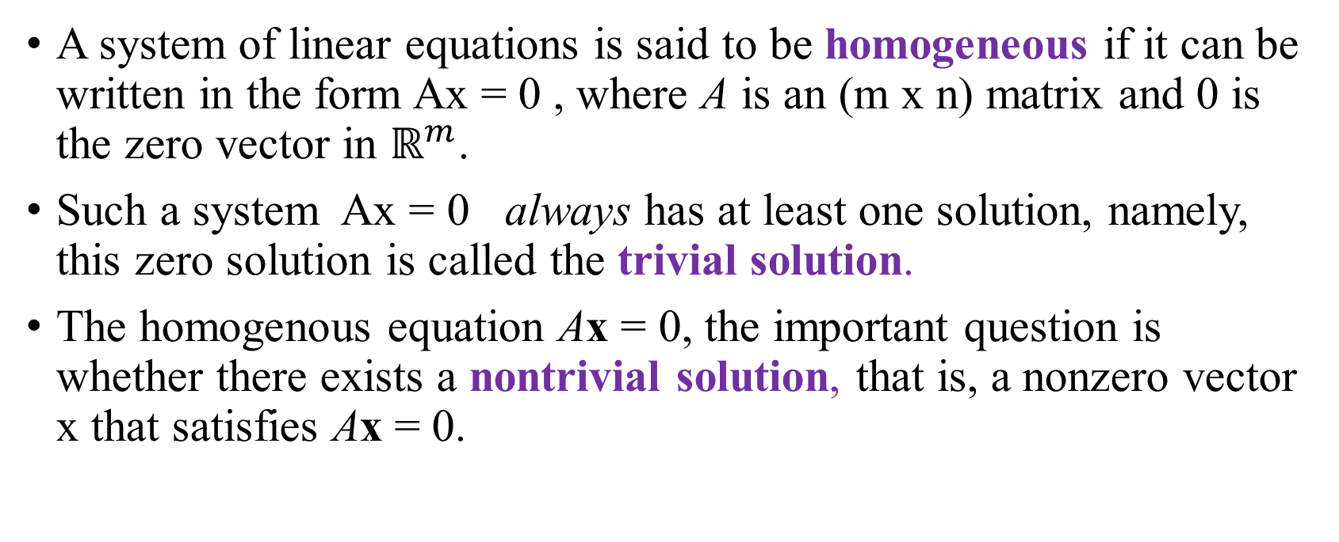
HOMOGENEOUS LINEAR SYSTEMS
A system of linear equations is said to be homogeneous if it can be written in the form Ax = 0 , where A is an (m x n) matrix and 0 is the zero vector in $ℝ^{m}$.
Such a system Ax = 0 always has at least one solution, namely, this zero solution is called the trivial solution.
The homogenous equation Ax = 0, the important question is whether there exists a nontrivial solution, that is, a nonzero vector x that satisfies Ax = 0.

Slide 48
HOMOGENEOUS LINEAR SYSTEMS
Example: Determine if the following homogeneous system has a nontrivial solution. Then describe the solution set.
Solution: Let A be the matrix of coefficients of the system and row reduce the augmented matrix [ A 0 ] to echelon form:

Slide 49
HOMOGENEOUS LINEAR SYSTEMS

Slide 50
PARAMETRIC VECTOR FORM
The equation of the form (s, t in ℝ) is called a parametric vector equation of the plane.
In Example 1, the equation (with x₃ free), or
(with t in ℝ), is a parametric vector equation of a line.
Whenever a solution set is described explicitly with vectors as in Example 1, we say that the solution is in parametric vector form.

Slide 51
SOLUTIONS OF NONHOMOGENEOUS SYSTEMS
Example : Describe all solutions of Ax = b , where
and

Slide 52
SOLUTIONS OF NONHOMOGENEOUS SYSTEMS
Solution: Row operations on [ A b ] produce
x₃ is free

Slide 53
SOLUTIONS OF NONHOMOGENEOUS SYSTEMS
As a vector, the general solution of Ax = b has the form
p
v

Slide 54
SOLUTIONS OF NONHOMOGENEOUS SYSTEMS
The equation , or, writing t as a general parameter,
(t in ℝ) (3)
describes the solution set of nonhomogeneous systems in parametric vector form.
On the other hand, the solution set of homogeneous systems has the parametric vector equation
(t in ℝ) (4)
[with the same v that appears in (3)].
Thus the solutions of are obtained by adding the vector p to the solutions of .

Slide 55
WRITING A SOLUTION SET (OF A CONSISTENT SYSTEM) IN PARAMETRIC VECTOR FORM
Row reduce the augmented matrix to reduced echelon form.
Express each basic variable in terms of any free variables appearing in an equation.
Write a typical solution x as a vector whose entries depend on the free variables, if any.
Decompose x into a linear combination of vectors (with numeric entries) using the free variables as parameters.

Slide 56
THANK YOU FOR LISTENING

